Slide 1
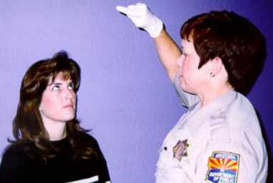
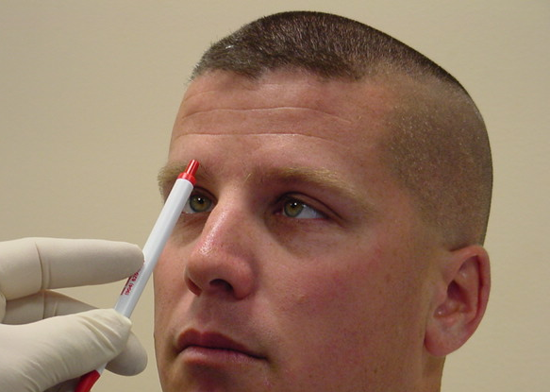



Session 5
Eye Examinations

Slide 2
Learning Objectives
State purpose of various eye examinations in the DEC Program drug influence evaluation procedure
Describe administrative procedures and clues for eye examinations
Conduct eye examinations and note clues observed
Prepare complete, clear and accurate records of eye examinations

Slide 3
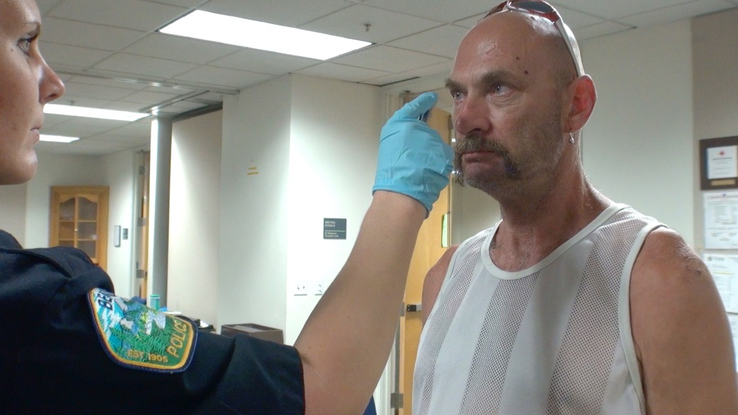
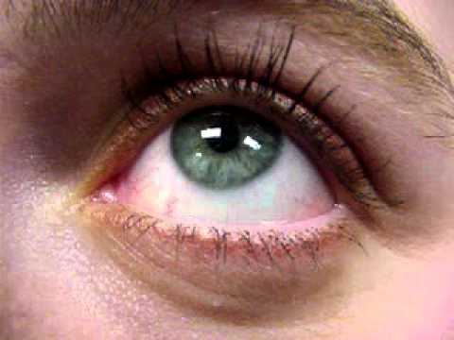
Purpose of Eye Examinations

Slide 4
Angle of Onset of Nystagmus
By comparing subject’s BAC with Angle of Onset of HGN, it may be possible to determine alcohol is or is not the sole cause of observed nystagmus
Consistency of Angle of Onset and BAC can be compared using the following formula:
BAC = 50 – Angle of Onset

Slide 5
Eye Examinations
Purpose of comparing BAC and Angle of Onset is to determine possible presence of another “DID” drug
LOC can also provide another clue as to possible presence of “DIDC” drugs

Slide 6
Pupil Size and Reaction to Light
Provide useful indicators of the possible presence of many drug categories
During the eye examinations, also check for rebound dilation

Slide 7
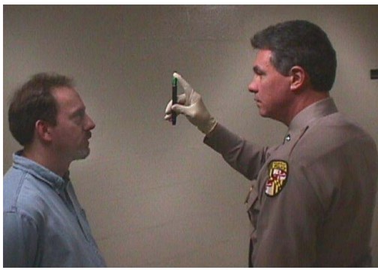
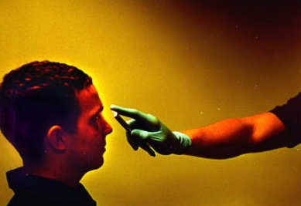
Eye Examinations

Slide 8
Three Clues of Horizontal Gaze Nystagmus
Lack of Smooth Pursuit
Distinct and Sustained Nystagmus at Maximum Deviation
Angle of Onset of Nystagmus

Slide 9
Vertical Gaze Nystagmus

Slide 10
Lack of Convergence

Slide 11
Eye Exams Practice
Preliminary
Equal Pupil Size
Resting Nystagmus
Tracking ability
Angle of onset
Eye Exams
HGN
VGN
LOC

Slide 12
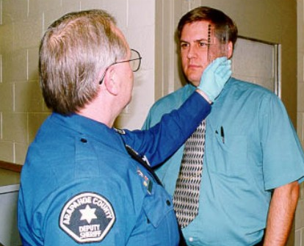
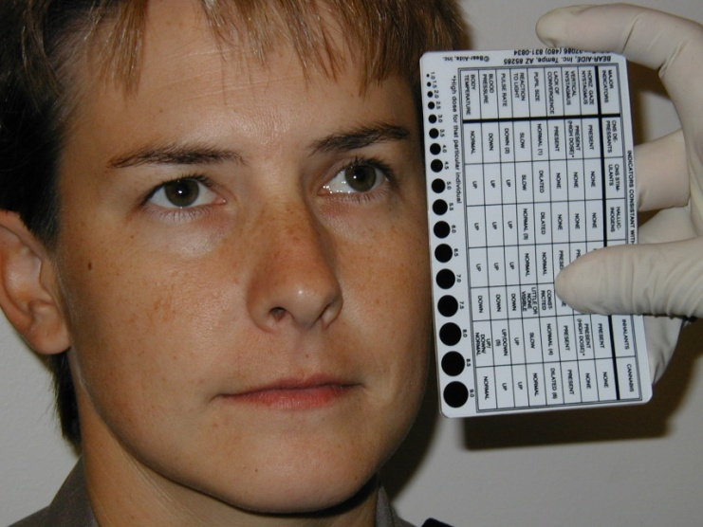
Estimation of Pupil Size

Slide 13
Pupillary Considerations

Slide 14

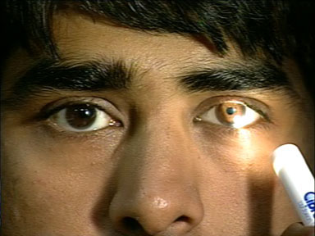
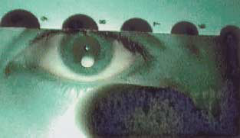
Three Lighting Conditions

Slide 15
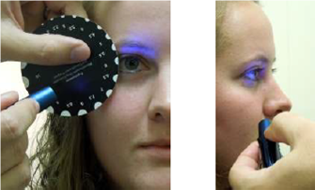
Estimation of Pupil Size – Near Total Darkness – UV Light

Slide 16

Estimation of Pupil Size – Near Total Darkness – UV Light

Slide 17
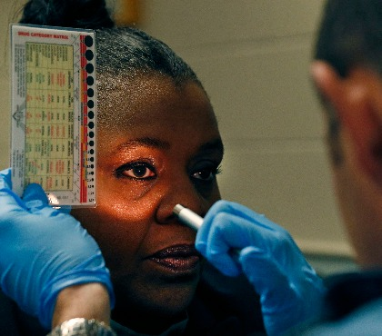
Estimation of Pupil Size – Direct Light

Slide 18
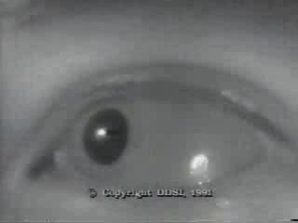
Rebound Dilation
A period of pupillary constriction followed by a period of pupillary dilation where the pupil steadily increases in size and the range between minimum and maximum is equal to or greater than 1mm and does not return to its original constricted size.
Click Picture to Play

Slide 19
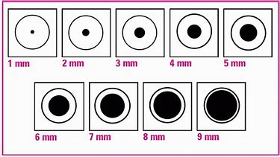
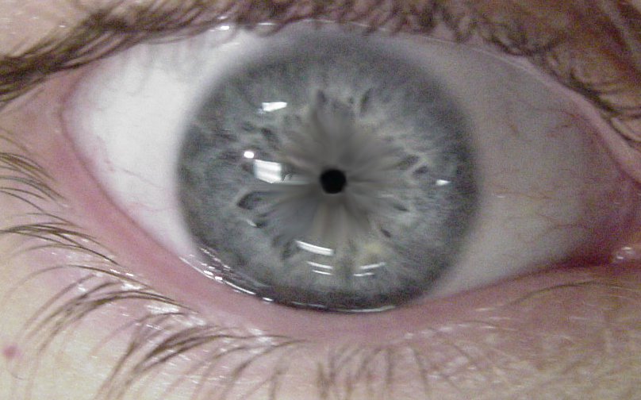
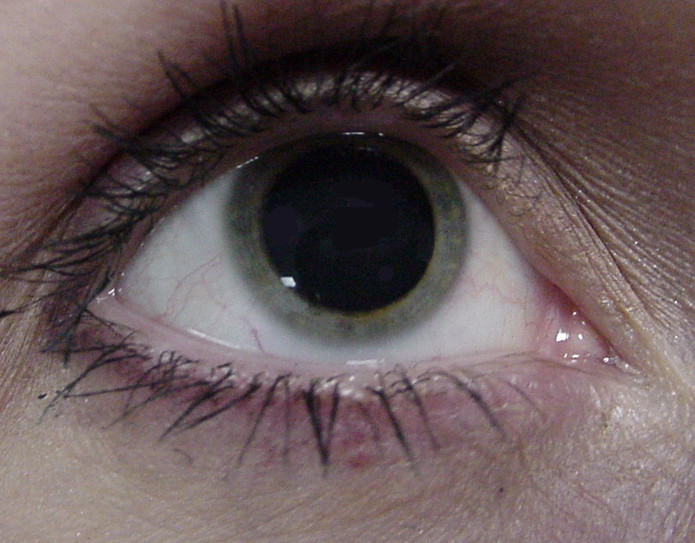
Pupil Ranges

Slide 20
Pupil Size Technical Terms
Miosis – abnormally small pupil (constricted)
Mydriasis – abnormally large pupil (dilated)

Slide 21
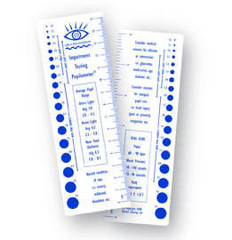
DRE Average Pupil Sizes

Slide 22

Reaction to Light
Assessment of how quickly pupil constricts to its smallest size during check of pupil size under direct light.

Slide 23
Demonstrations

Slide 24
Demonstration of Pupil Size and Reaction to Light Checks
Room Light
Dark Room Checks of Pupil Size
Near Total Darkness
Direct Light
Reaction to Light

Slide 25
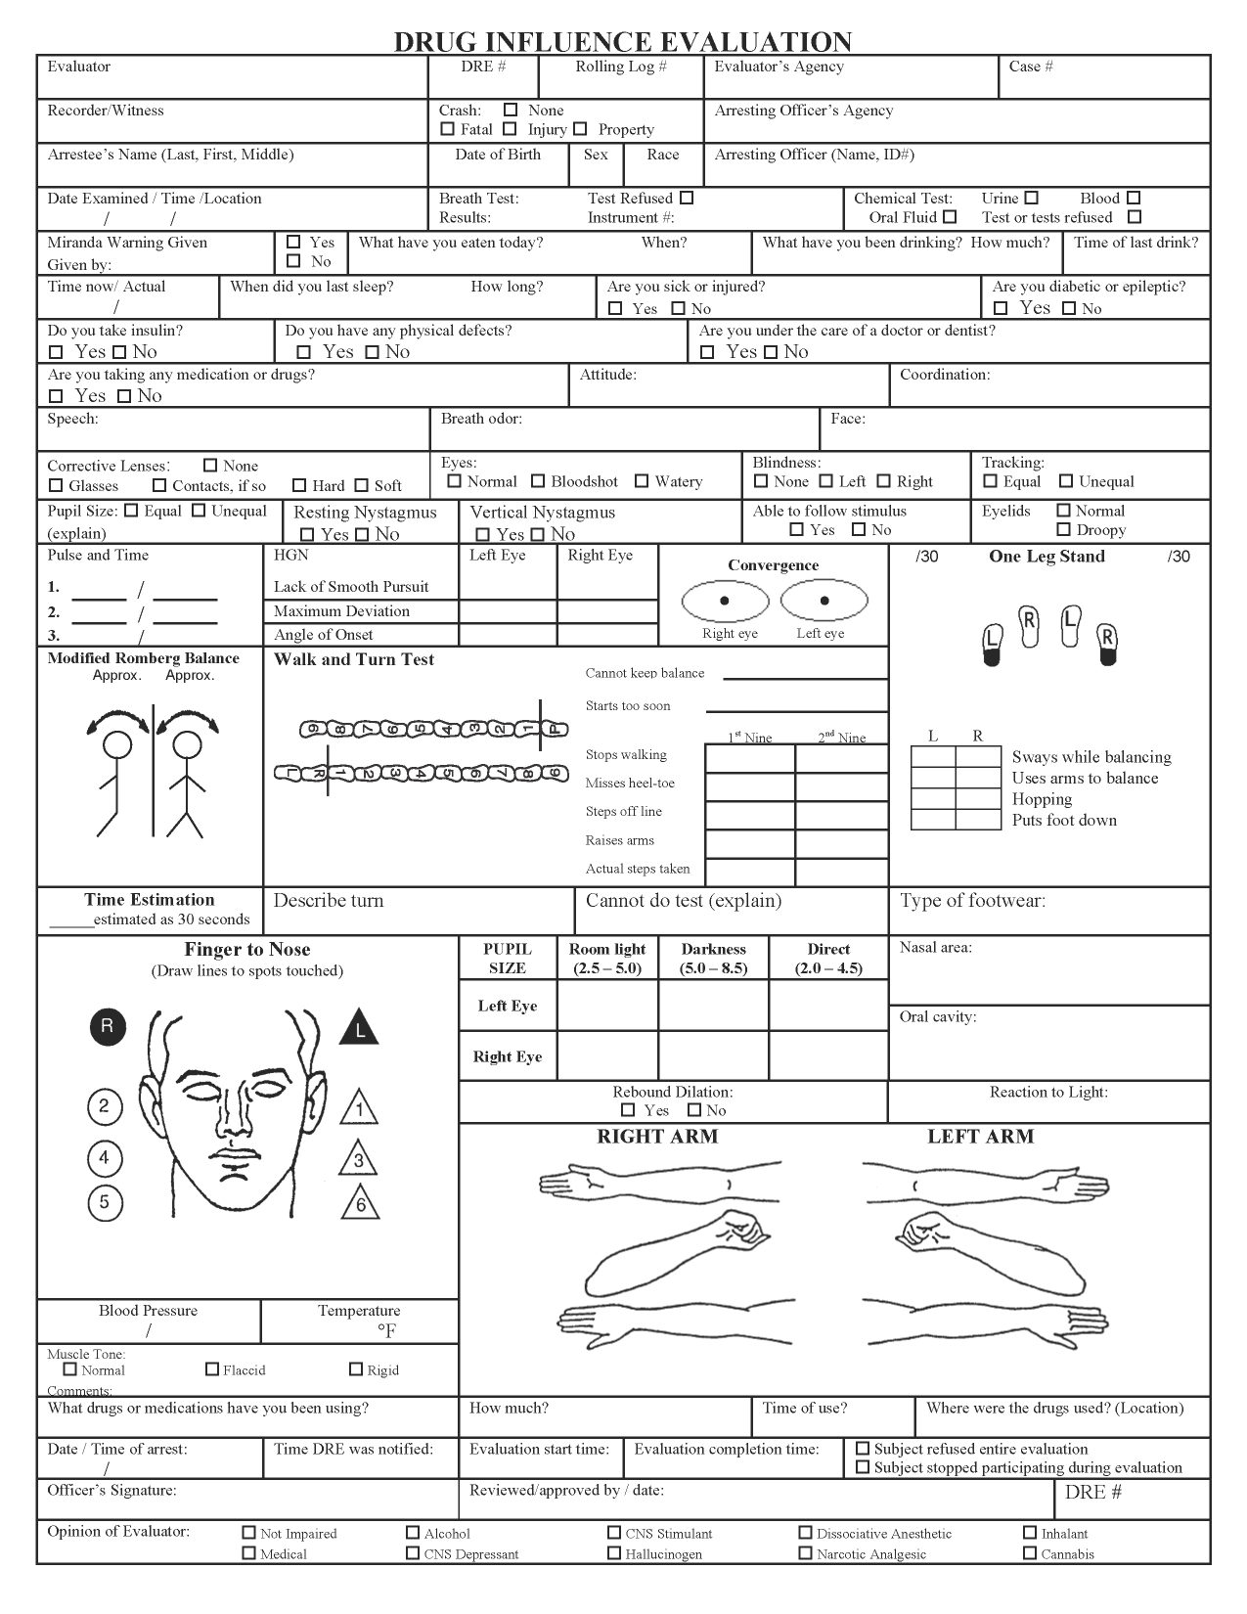
Sample Eye Examination

Slide 26
Questions?

